Slide 1
Sublinear time algorithms
Ronitt Rubinfeld
Computer Science and Artificial Intelligence Laboratory (CSAIL)
Electrical Engineering and Computer Science (EECS)
MIT

Slide 2

Massive data sets
examples:
  sales logs
  scientific measurements
  genome project
  world-wide web
  network traffic, clickstream patterns
in many cases, hardly fit in storage
are traditional notions of an efficient algorithm sufficient?
  i.e., is linear time good enough?

Slide 3
Some hope:
Don’t always need exact answers...

Slide 4
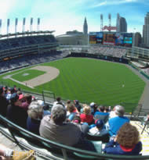
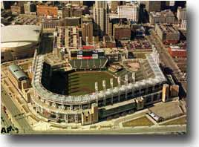
“In the ballpark” vs. “out of the ballpark” tests
Distinguish inputs that have specific property from those that are far from having the property
Benefits:
  May be the natural question to ask
  May be just as good when data constantly changing
  Gives fast sanity check to rule out very “bad” inputs (i.e., restaurant bills) or to decide when expensive processing is worth it

Slide 5

Settings of interest:
Tons of data – not enough time!
Not enough data – need to make a decision!

Slide 6
Example 1:
Properties of distributions

Slide 7




Trend change analysis
Transactions of 20-30 yr olds
Transactions of 30-40 yr olds
trend change?

Slide 8

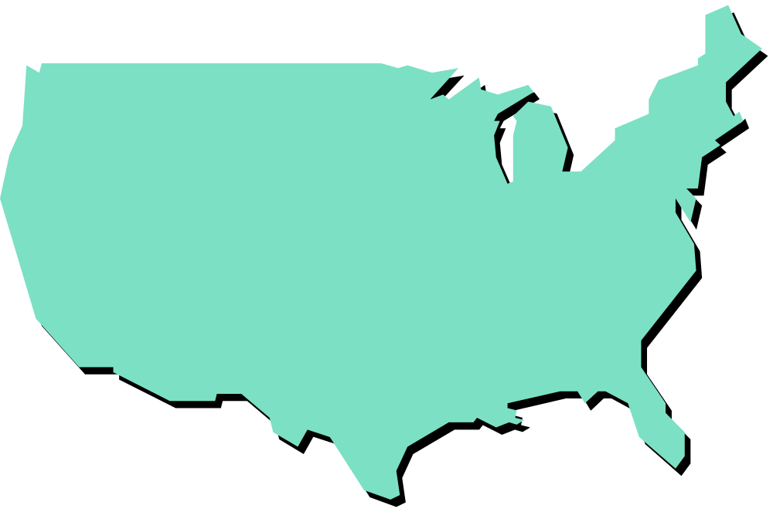

Outbreak of diseases
Do two diseases follow similar patterns?
Are they correlated with income level or zip code?
Are they more prevalent near certain areas?

Slide 9
Is the lottery uniform?
New Jersey Pick-k Lottery (k =3,4)
  Pick k digits in order.
  10^{k} possible values.
Data:
  Pick 3 - 8522 results from 5/22/75 to 10/15/00
    χ²-test gives 42% confidence
  Pick 4 - 6544 results from 9/1/77 to 10/15/00.
    fewer results than possible outcomes
    χ²-test gives no confidence

Slide 10
Information in neural spike trails
Apply stimuli several times, each application gives sample of signal (spike trail) which depends on other unknown things as well
Study entropy of (discretized) signal to see which neurons respond to stimuli
[Strong, Koberle, de Ruyter van Steveninck, Bialek ’98]
Neural signals
time

Slide 11
Global statistical properties:
Decisions based on samples of distribution
Properties: similarities, correlations, information content, distribution of data,…
Focus on large domains

Slide 12

Distributions with large domains:
Right kind of sample data is usually a scarce resource
Standard algorithms from statistics (χ² –test, plug-in estimates, naïve use of Chernoff bounds,…)
  number of samples > domain size
  for stores with 1,000,000 product types, need > 1,000,000 samples to detect trend changes
Our algorithms use only a sublinear number of samples.
  for our example, need t 10,000 samples

Slide 13
Our Analysis:
For infrequent elements, analyze coincidence statistics using techniques from statistics
  Limited independence arguments
  Chebyshev bounds
Use Chernoff bounds to analyze difference on frequent elements
Combine results using filtering techniques

Slide 14
Example 2:
Pattern matching on Strings
Are two strings similar or not? (number of deletions/insertions to change one into the other)
  Text
  Website content
  DNA sequences
ACTGCTGTACTGACT (length 15)
CATCTGTATTGAT (length 13)
match size =11

Slide 15
Pattern matching on Strings
Previous algorithms using classical techniques for computing edit distance on strings of size n use at least n² time
  For strings of size 1000, this is 1,000,000
  Our method uses << 1000
  Our mathematical proofs show that you cannot do much better

Slide 16
Our techniques:
Can’t look at entire string…
So sample according to a recursive fractal distribution
Clever use of approximate solutions to subproblems yields result

Slide 17
Other examples:
Testing properties of text files
  Are there too many duplicates?
  Is it in sorted order?
  do two files contain essentially the same set of names?
Testing properties of graph representations
  High connectivity?
  Large groups of independent nodes?

Slide 18
Conclusions
sublinear time possible in many contexts
  new area, lots of techniques
    pervasive applicability
    Algorithms are usually simple, analysis is much more involved
    savings factor of over 1000 for many problems
  what else can you compute in sublinear time?
  other applications...?

